Slide 1



Part 4: Database Presentation
PLATE MATE
HEALTHY
FOOD
BMS0601
Firas Zaghab
Elizabeth Gomes
Zixuan Wu
Percival Masaline
Channele Sawyer

Slide 2
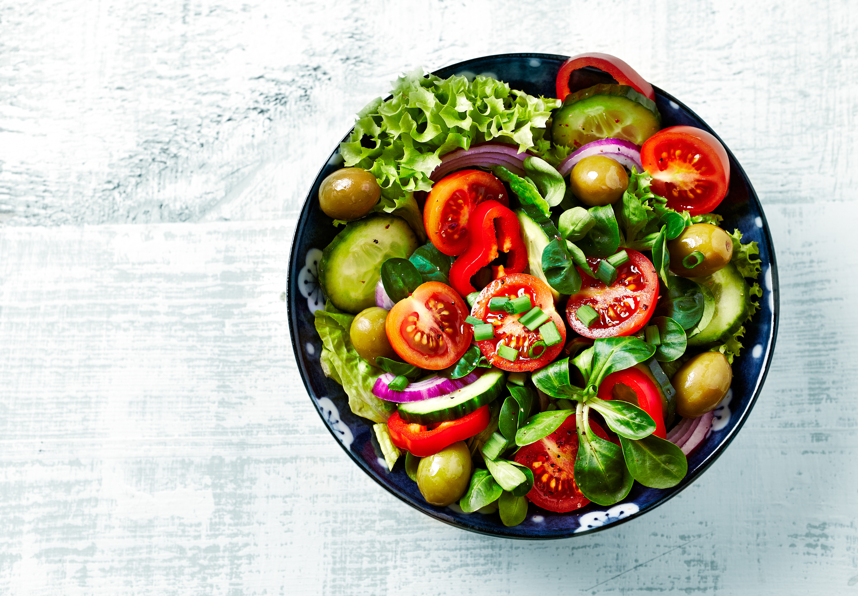


Plate Mate
Healthy Meal Plan Delivery Service
77%
Welcome To Plate Mate
Our Story
At Plate Mate, we believe that everyone should have access to healthy, delicious meals that fit their busy lifestyle. We source only the highest-quality ingredients, using local and organic products whenever possible, and prepare each meal with care and attention to detail. We are committed to providing personalized service and creating a seamless delivery experience for our customers, so they can focus on what matters most - enjoying great food and living their best life.
Learn More

Slide 3
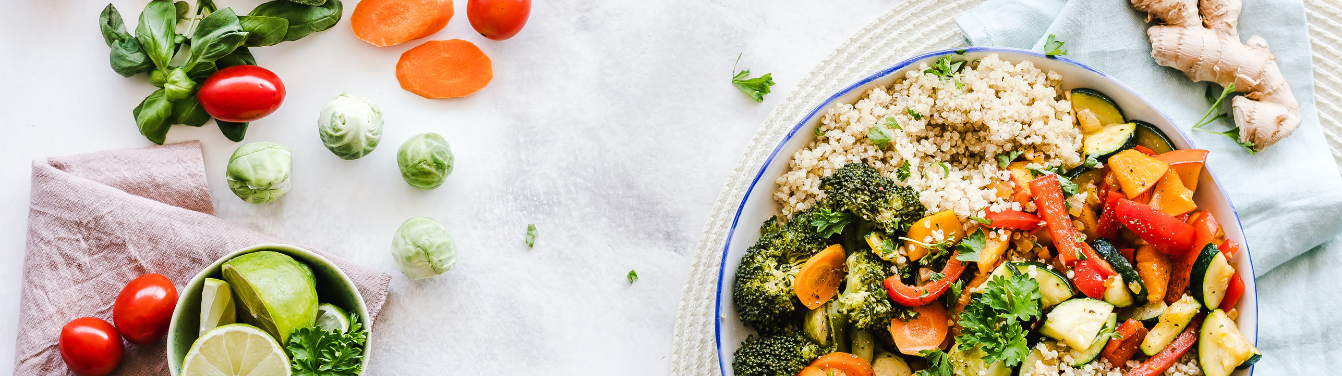

Plate Mate
Our Mission
Our Mission is to create a relational database system for Plate Mate to store transactional and operational data related to orders and deliveries, customer accounts, subscriptions accounts, subscription plans, supplier information such as vendors, products, meals, orders and delivery information all in one place.
Learn More

Slide 4


Plate Mate
Plate Mate
Mission Objectives
01
The database will store data for individual customers such as customer accounts, past orders, subscription accounts, contact information.
02
The database will store data for individual subscriber accounts such as subscriber identification, subscription plant types, cost and date of enrollment in each plan.
03
The database will store information pertaining to subscription plan types such as cost of weekly, bi-weekly and monthly subscription types.
100%
04
The system will track all order transactions and maintain data related to each order such as order numbers, order items, order dates, and delivery information.
Natural

Slide 5
Plate Mate
Plate Mate
Mission Objectives
05
The system will track delivery data such as driver information, delivery date, meals delivered, and customer account associated with delivery.
06
The database will store meal information such as vegan ,vegetarian, and gluten free meal types, as well as products used in the meals.
07
The database will store vendor contact information and track products supplied by each vendor.
100%
08
The database will store products such as product name, price and supplier.
Natural

Slide 6
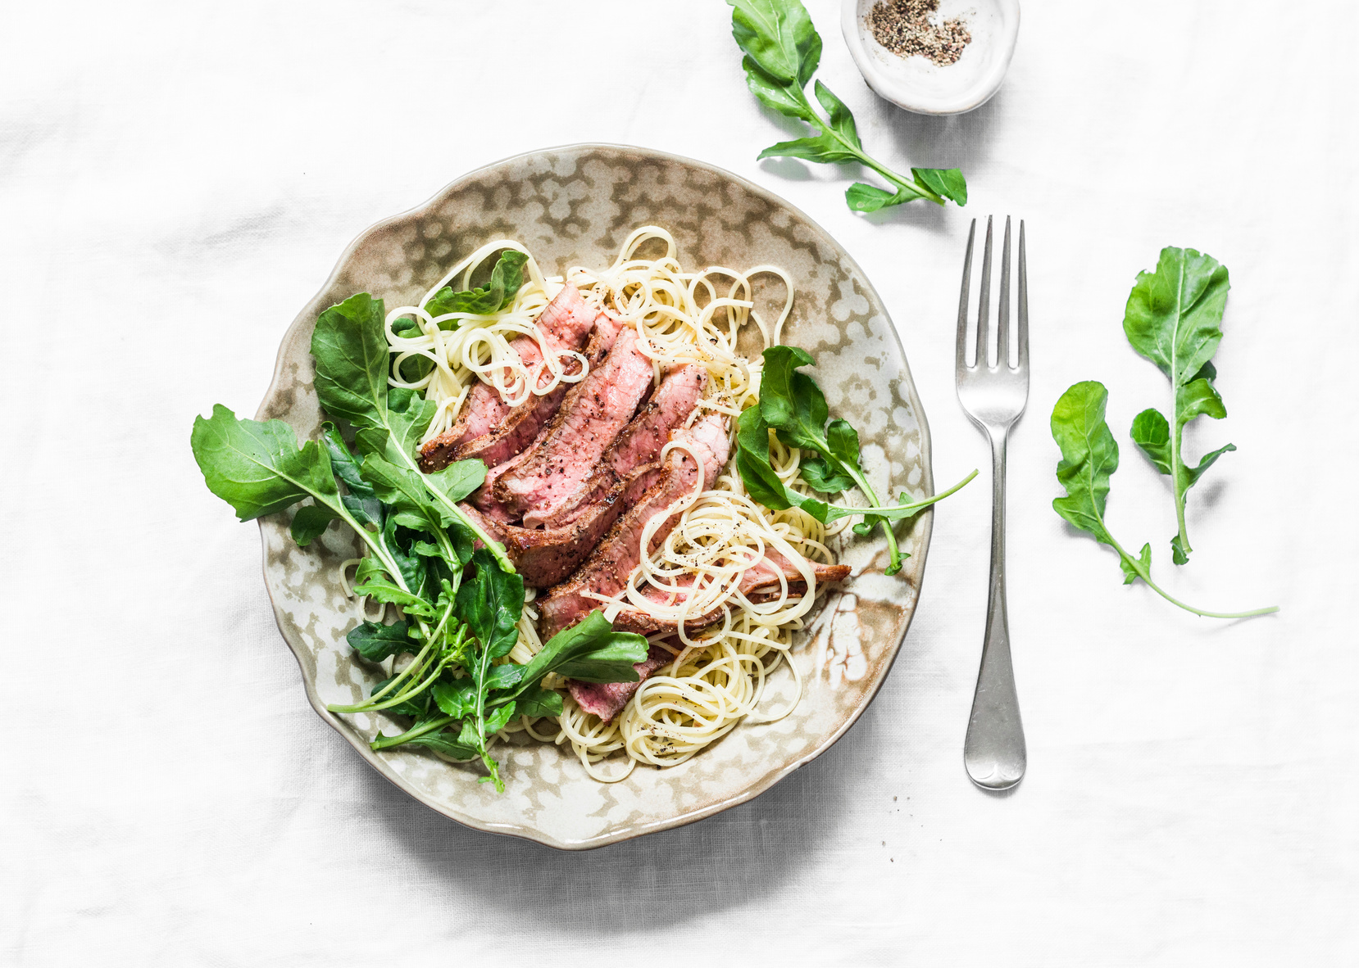
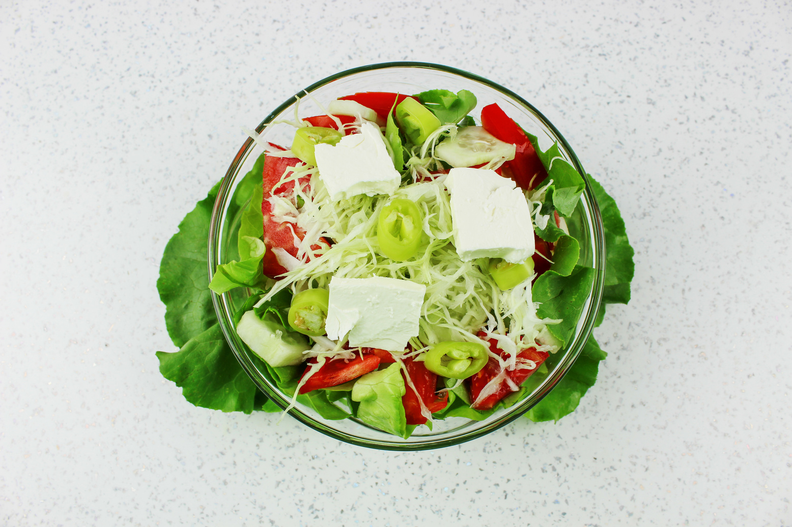
Plate Mate
Plate Mate
Business Rules
R1
A customer can have multiple subscriptions. A subscription must belong to one customer
R2
There are three subscription types available for a customer to choose from - Weekly, Bi-Weekly, and Monthly.
R3
An order can only belong to one customer. A customer can place many orders.
R4
A placed order can consist of several meals (up to 4 meals). A meal can be included in any order.

Slide 7
Plate Mate
Plate Mate
Business Rules
R5
There are 3 Meal Types for customers to choose from, Vegan, Vegetarian and Gluten Free. An individual meal cannot be classified as multiple types.
R6
A meal must contain at least one product and usually contains various products. A product can be used in various meals.
R7
A product must be supplied by one vendor. A vendor can supply multiple products.
R8
A delivery driver can deliver many orders. An order can only be delivered by one driver.

Slide 8
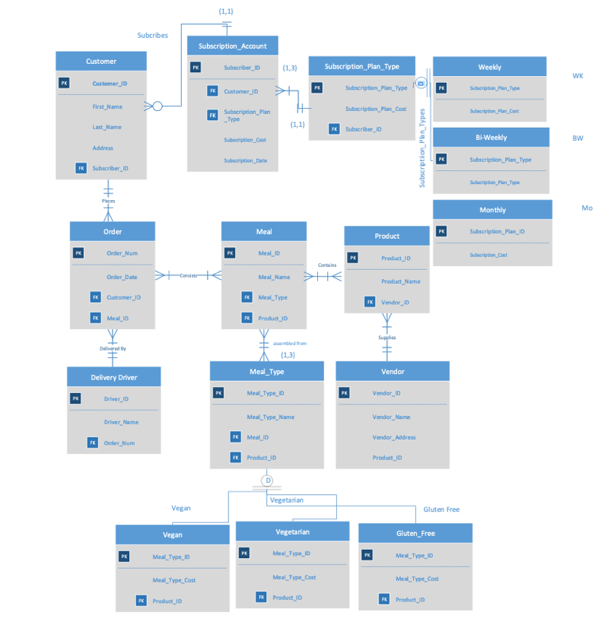
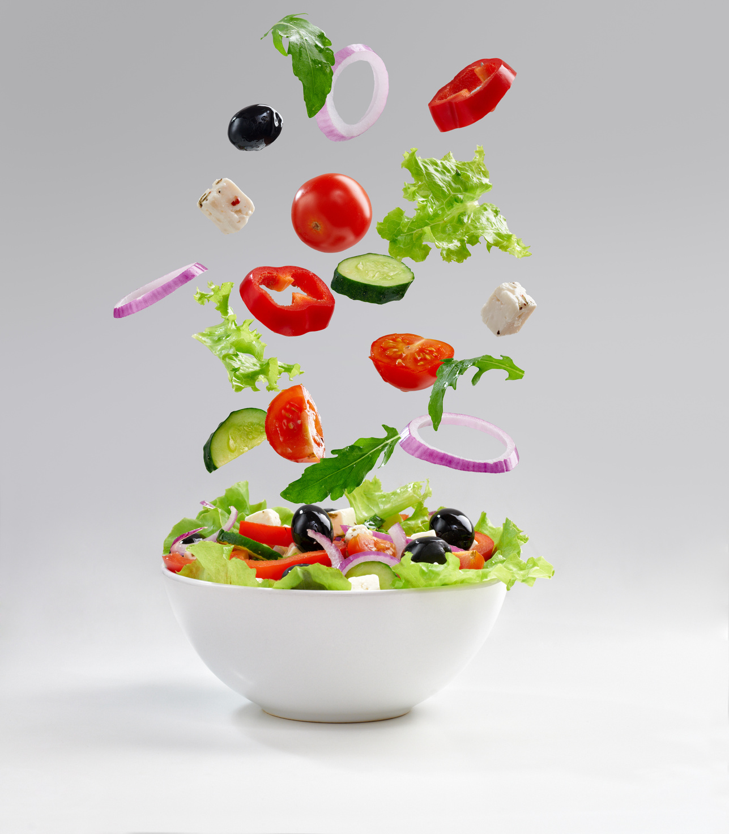
ER Diagram

Slide 9
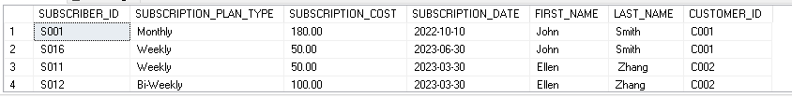
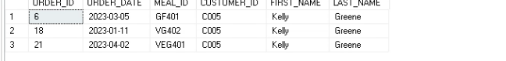
Plate Mate
Plate Mate
Queries
LA customer can have multiple subscriptions. A subscription must belong to one customer. SELECT G4_SUBSCRIPTION_ACCOUNT.SUBSCIPTION_PLAN_TYPE, G4_SUBSCRIPTION_ACCOUNT.SUBSCRIPTION_DATE, G4_SUBSCRIPTION_ACCOUNT.FIRST_NAME, G4_SUBSCRIPTION_ACCOUNT.LAST_NAME,G4_SUBSCRIPTION_ACCOUNT.SUBSCRIPTION_DATE,G4_SUBSCRIPTION_ACCOUNT.SUBSCRIPTION_COST,G4_CUSTOMER.CUSTOMER_ID FROM G4_SUBSCRIPTION_ACCOUNT INNER JOIN G4_CUSTOMER ON G4_SUBSCRIPTION_ACCOUNT.CUSTOMER_ID = G4_CUSTOMER.CUSTOMER_ID WHERE G4_SUBSCRIPTION_ACCOUNT.CUSTOMER_ID > '1' AND SUBSCRIPTION_DATE BETWEEN '2022-10-10' AND '2023-01-10' ORDER BY CUSTOMER_ID;
01
An order can belong to one customer. A customer can have many orders. SELECT G4_ORDER.ORDER_ID,G4_ORDER.ORDER_DATE,G4_0RDER.MEAL_ID,G4_CUSTOMER.CUSTOMER_ID,G4_CUSTOMER.FIRST_NAME,G4_CUSTOMER_LAST_NAME FROM G4_CUSTOMER INNER JOIN G4_ORDER ON G4_CUSTOMER.CUSTOMER_ID=G4_ORDER,CUSTOMER_ID WHERE G4_CUSTOMER.ORDER_ID >' 1' AND FIRST_NAME LIKE '%KELLY'%
02
100%
Natural

Slide 10
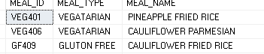
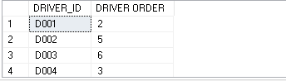
Plate Mate
Plate Mate
Queries
THERE ARE 3 MEAL TYPES TO CHOOSE FROM VEGAN,VEGETARIAN, AND GLUTON-FREE. AN INDIVIDUAL MEAL CANNOT BE CLASSIFIED AS MULTIPLE TYPES.
CREATE VIEW [MEAL TYPES] AS
SELECT G4_MEAL .MEAL_NAME,G4_MEAL.MEAL_TYPE FROM G4_MEAL WHERE MEAL_TYPE >'2'; SELECT * FROM[MEAL TYPES];
03
A DELIVERY DRIVER CAN ONLY DELIVER MANY ORDERS,AN ORDER CAN ONLY BE DELIVERED BY ONE DRIVER. SELECT G4_ORDER.DRIVER_ID, COUNT(*)AS 'DRIVER ORDER' FROM G4_ORDER GROUP BY G4_ORDER.DRIVER_ID HAVING COUNT (*) >=1; ,
04
100%
Natural

Slide 11
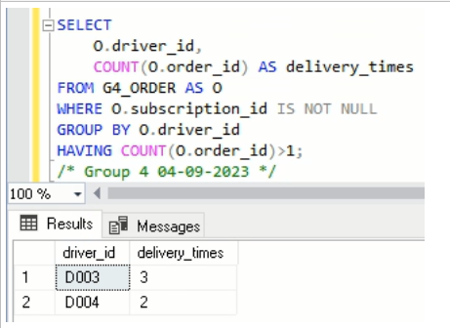
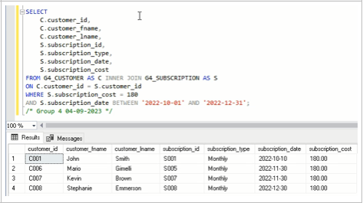
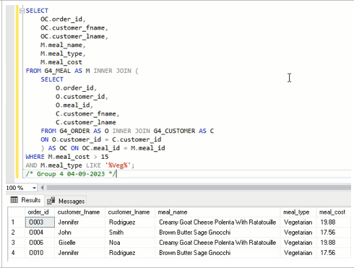
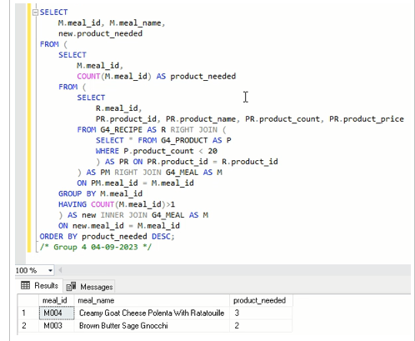
Subscription Cost by Customers and Sub Types
Driver Delivery Status
70%
Queries
Meal Cost per Customer
Product Needed for Each Meal
93%
65%
30%

Slide 12
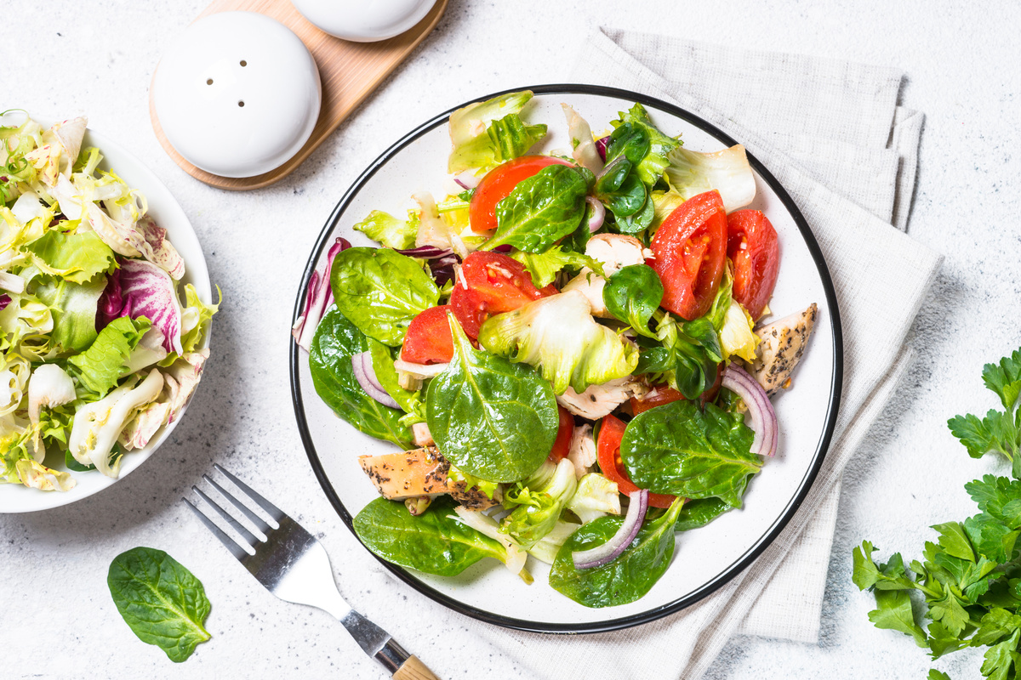
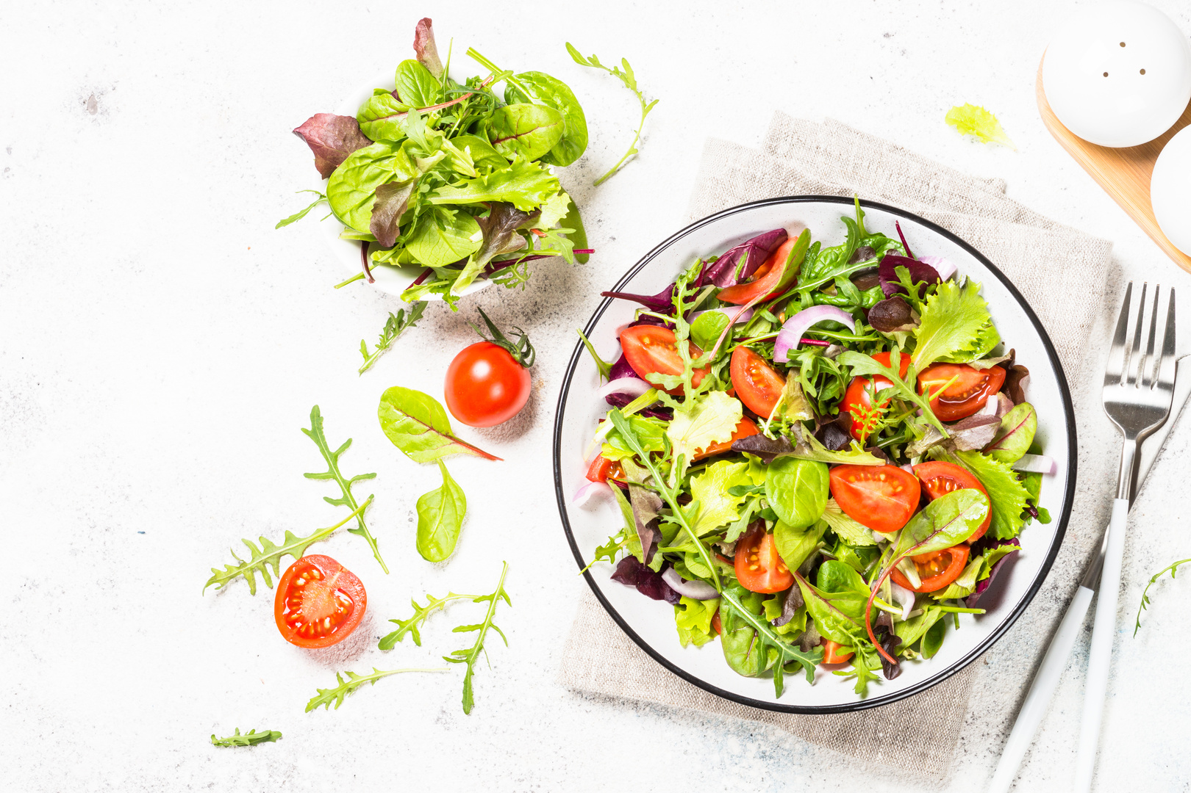
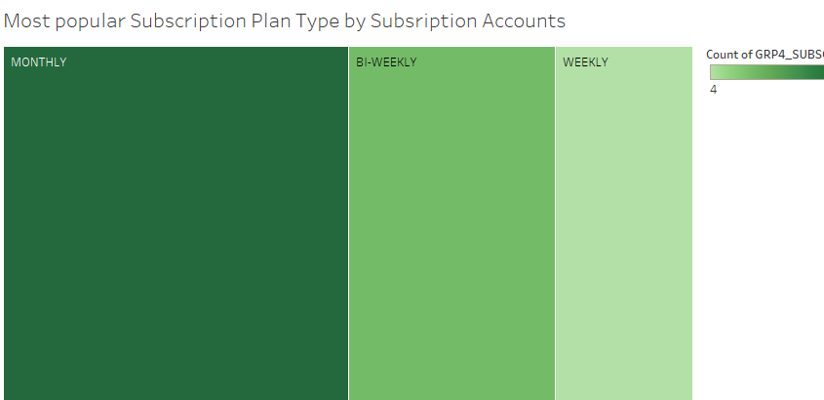
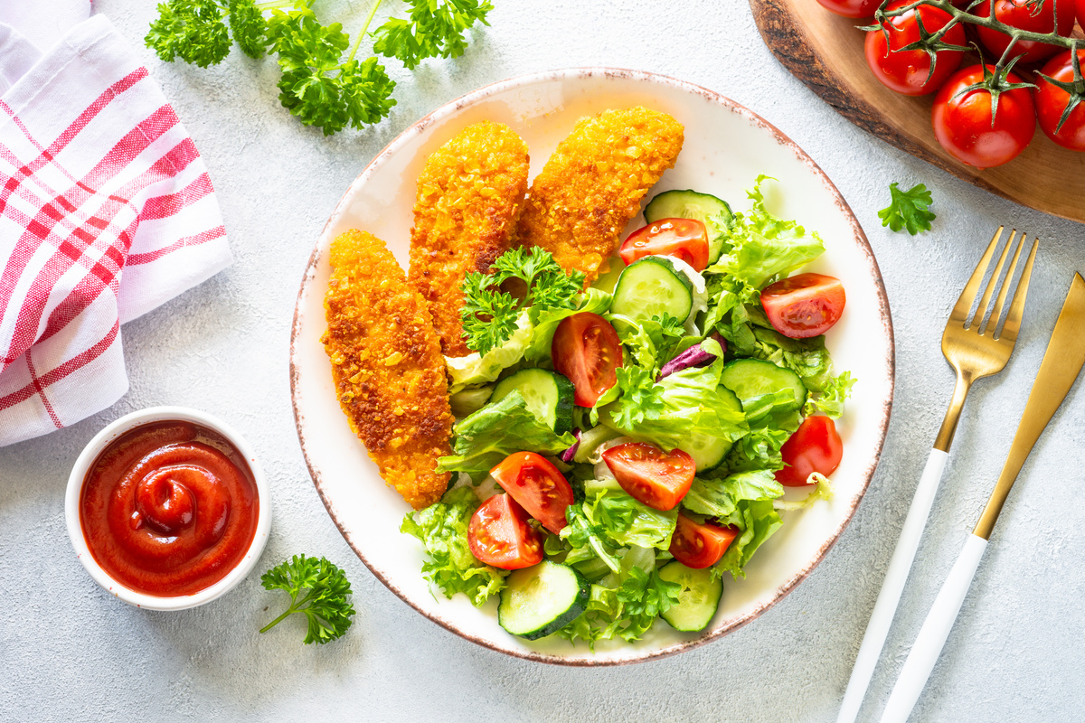
Plate Mate
Plate Mate
Subscription Plan Types
Weekly
Tableau Visualization of most popular Subscription Plan Type by Subscription Account or number of subscribers. The data indicates that the Monthly subscription is Plate Mates most popular plan.
$ 50.00
Bi-weekly
$ 100.00
Monthly
$ 180.00

Slide 13
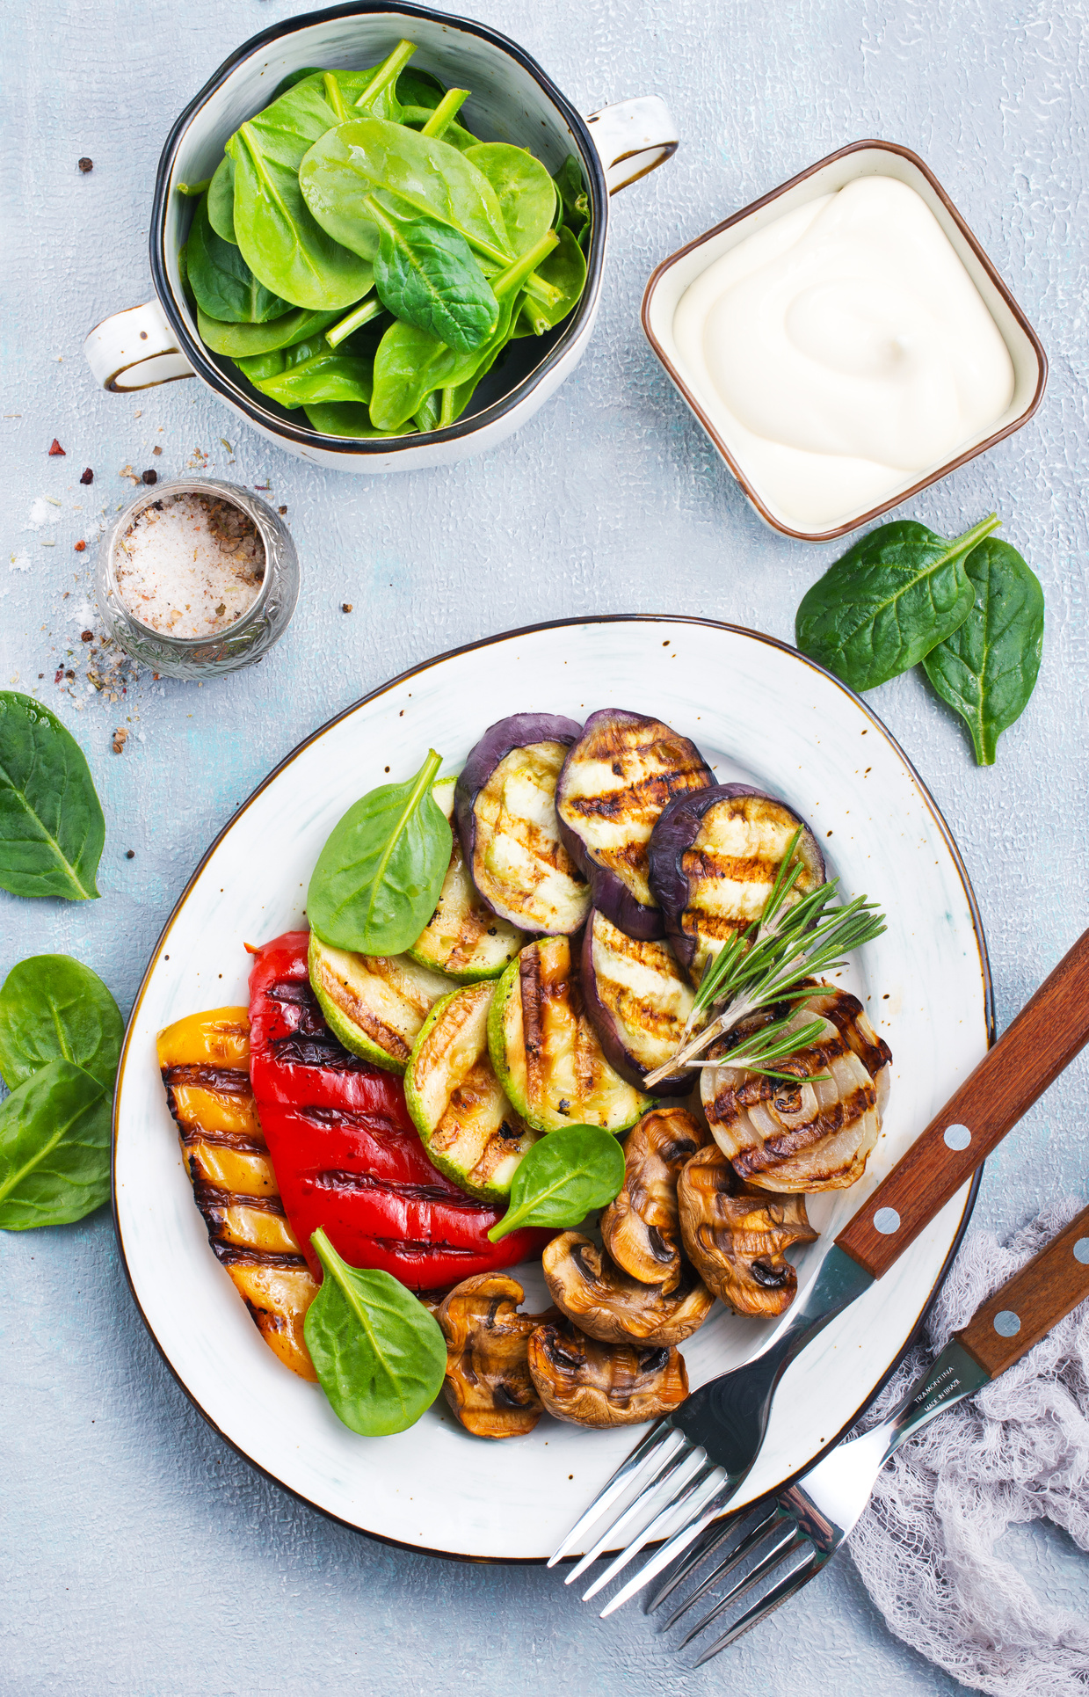
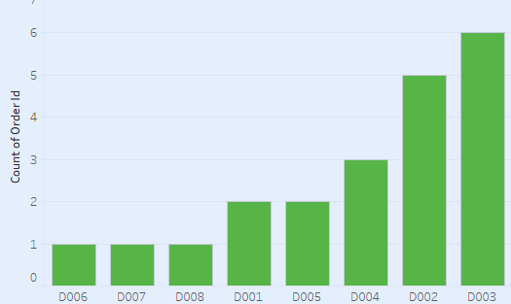
Plate Mate
Plate Mate
Tableau Visualization for Number of Orders delivered per Driver in a specified time frame. The data indicates that driver 'D003; delivered the most orders during this period.
+123-456-7890
hello@reallygreatsite.com
www.reallygreatsite.com
123 Anywhere ST., Any City

Slide 14
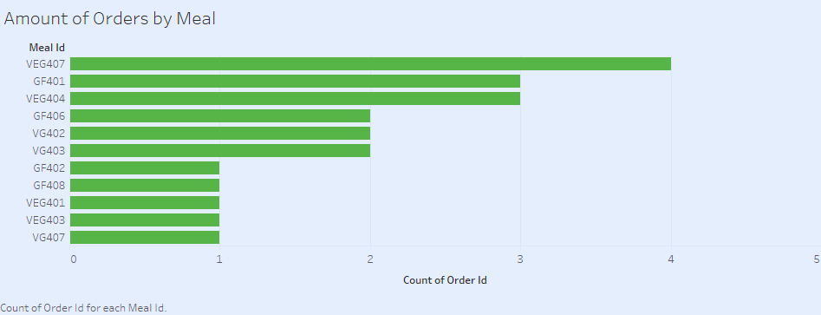
Plate Mate
Plate Mate
Tableau Visualization for Number of Orders delivered per Meal in specified in a specified time frame to determine most popular meals. The data indicates that VEG407 OR VEGETARIAN PUMPKIN CURRY was the most ordered meal during this period.
+123-456-7890
hello@reallygreatsite.com
www.reallygreatsite.com
123 Anywhere ST., Any City

Slide 15
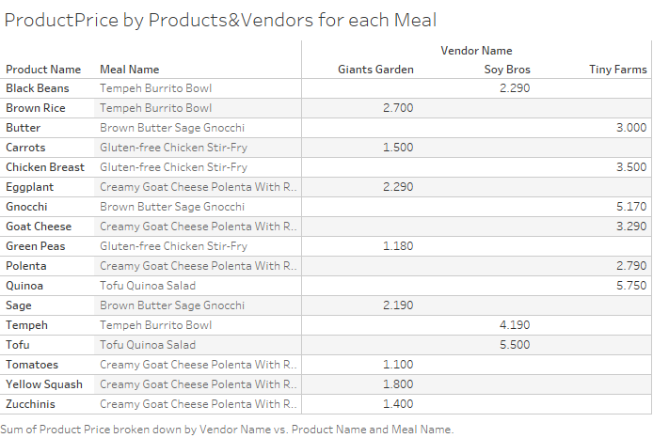

Slide 16
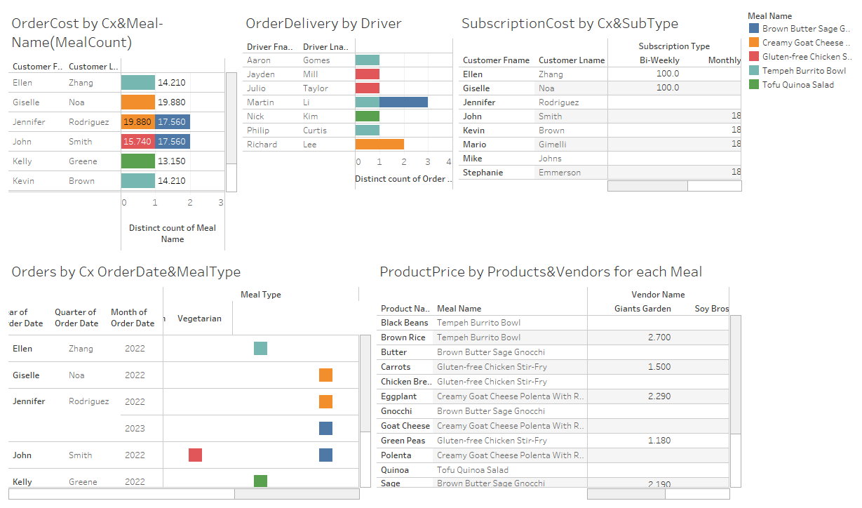
Dashboard

Slide 17
PLATE MATE
THANK'S
FOR WATCHING
WE PLEDGE ON OUR HONOR THAT WE HAVE NOT GIVEN OR RECEIVED ANY UNAUTHORIZED ASSISTANCEON THIS ASSIGNMENT

